Slide 1
Virtual Design Review 1
Team 513
Automated Shaft Flux Measurement Device

Slide 2
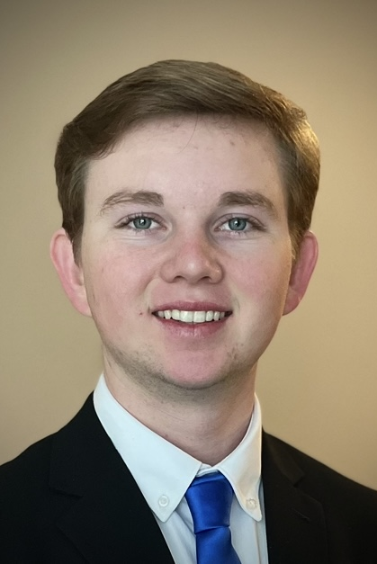
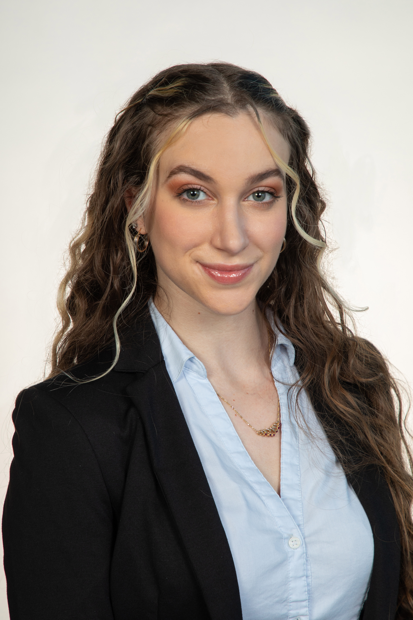
Team Introductions
Liora Louis
Andrew Atallah
Hardware Engineer
Sean Hemstreet
Design Engineer
Joshua Huls
Systems Engineer
Liora Louis
Materials &
Test Engineer

Slide 3
Sponsor and Advisor
Liora Louis
Engineering Mentor
William Bilbow
Director of Technology & Project Manager
Engineering Mentor
Cole Gray
Mechanical Design Engineer
Academic Advisor
Dr. Shayne McConomy
Senior Design Professor

Slide 4
Objective
Liora Louis
The objective of this project is to design a device that will be capable of fully measuring and recording the magnetic flux of compressor shafts in an automated way that allows for accurate measurements, repeatability, and less overall firsthand work for the operator.

Slide 5
Primary Market
Liora Louis

Slide 6
Secondary Market
Liora Louis
Competing Companies
Research Facilities

Slide 7
Secondary Market
Liora Louis
Competing Companies
Research Facilities

Slide 8
Secondary Market
Liora Louis
Competing Companies
Research Facilities

Slide 9
Key Goals
Automated
Consistent
Adaptable
Accurate
Liora Louis

Slide 10
Key Goals
Automated
Consistent
Adaptable
Accurate
Liora Louis

Slide 11
Key Goals
Automated
Consistent
Adaptable
Accurate
Liora Louis

Slide 12
Key Goals
Automated
Consistent
Adaptable
Accurate
Liora Louis

Slide 13
Key Goals
Automated
Consistent
Adaptable
Accurate
Liora Louis

Slide 14
Stakeholders
Liora Louis
Danfoss
Cole Gray and William Bilbow
Dr. Shayne McConomy
14

Slide 15
Assumptions
Joshua Huls
Device is used over a period of 3 months per year.

Slide 16
Assumptions
Joshua Huls
Device is used over a period of 3 months per year.
MATLAB or an open-source software.

Slide 17
Assumptions
Joshua Huls
Device is used over a period of 3 months per year.
MATLAB or an open-source software.
Given one working fluxmeter and sensor.

Slide 18
Assumptions
Joshua Huls
Device is used over a period of 3 months per year.
MATLAB or an open-source software.
Given one working fluxmeter and sensor.
Testing will be performed at Danfoss.

Slide 19
Customer Needs
Why does an automated flux measurement device need to be made?
The current
method is very
time intensive
and inconsistent.
Joshua Huls
The purpose of this system is to provide
a consistent and non-labor-intensive
flux measurement method.

Slide 20
Customer Needs
What types of shafts will we measure?
The system
must be
compatible with
VT series shafts.
Joshua Huls
The fixture must be able to support the dimensions of the desired shafts and ensure a repeatable process.

Slide 21
Customer Needs
What is the desired measurement resolution?
5 mm intervals around the perimeter and in the axial direction.
Joshua Huls
The system needs to have measurement resolution of 5 mm in the axial & circumferential directions.

Slide 22
Functional Decomposition
Joshua Huls
AFM
Human Interaction
System
Controls

Slide 23
Functional Decomposition
Joshua Huls
Human Interaction
Sample Setup
Parameters
Loading sample
Unloading sample
Activating electronic systems
Setting initial conditions

Slide 24
Functional Decomposition
Joshua Huls
AFM
Human Interaction
System
Controls

Slide 25
Functional Decomposition
Joshua Huls
System
Frame
Movement
Moves at consistent intervals
Moves at a controlled speed
Secures sample
Levels sample

Slide 26
Functional Decomposition
Joshua Huls
AFM
Human Interaction
System
Controls

Slide 27
Functional Decomposition
Joshua Huls
Controls
Hardware
Provides reliable measurement feedback
Software
Collects sensor data
Transfers sensor data

Slide 28
Future Work
Joshua Huls
Research
Targets and Metrics
Concept Generation
Final Selection

Slide 29
Backup Slides

Slide 32
Portion of the shaft being measured

Slide 33
Customer Needs – All Questions
Question Asked | Customer Statement | Interpreted Need
What is the purpose for designing this specific flux measurement device and how will this device differ from what is already on the market? | The purpose of this device is to simplify user interaction and for it to take reliable and accurate measurements. The current device was built as a temporary placeholder and is no longer an efficient method. There is no current device that satisfies our needs. | The purpose of this system is to provide a consistent and non-labor-intensive flux measurement method.
What are physical restrictions the team should consider, and should this be designed with the purpose of being compatible with other devices? | Due to the strong magnetic fields induced by the shafts, you should try to limit the number of magnetic components near the shaft. | Manufacture the device with mostly nonmagnetic components in the areas near the shaft.
How is the magnetic flux measured now? What is bad about it? | A flux meter and sensor are manually held and placed on the shaft, and measured values are manually entered. It is too much work for the operator. | The current measuring device is very hands on and requires a lot of input from the operator. We are tasked with partly replacing the manual labor with automated work by the device.
Why is automation important to this task? | Current operators are spending 8 hours, on average, per test. | Limiting labor intensity is a main objective of this project.
What is the variation of sizes of shafts that will be measured by this device? | The shafts that will be measured with this device will be about 3 feet long and weigh around 60 pounds. | The shafts being measured are long and heavy. The device will have a moderate safety factor to account for the weight and be able to make contact over the whole length of the flux region.
What types of shafts should this device be able to measure? | The fixture needs to accommodate the VT Series shafts. Time permitting, the fixture should be compatible with the 2 pole TT series shafts. | Our main goal is to build a fixture for the VT Series Shafts. If this is completed, we will expand onto the 2 pole TT Series Shafts and beyond.
What is the minimum resolution that this device should measure? | Needs to have 5 mm axial and circumferential resolution. Highly preferred to select up to 1 mm resolution. | The intervals for the magnetic flux resolution are at most 5 mm axially and 5 mm circumferential.
What is the most desirable metric of the system? | The most important metrics are reliability, repeatability, and automation. These are more important than the speed of the device. | Our project will require the use of software to enable automation. The system must be carefully designed to ensure a high confidence level.
Where does the legacy device get stored at Danfoss? Does it get moved around for testing? | The current device gets stored on top of a cabinet inside the machine shop. And when it is used, the operator must move it around and set it on a table. It doesn’t have a designated spot but if the new device works well enough, we will find a permanent spot for it. | The new device is preferred be small enough to be easily moved around by 1 to 2 people for testing.
Where will we complete prototype testing? | Due to the NDA, all testing must be done at Danfoss. | The new device will only be able to be tested inside their facility under supervision of the team’s technical advisors.

Slide 34
Current flux measurement system

Slide 35
Customer WANTs
Joshua Huls
Selectable resolution up to 1 mm for circumferential and axial motion
Fixture adaptability for two-pole shafts
Process of flux measurement and data collection for the desired test area must be fully automated
A fixture to stabilize desired shaft (and ensure reliable results)
A software application that can be opened via a desktop shortcut
A system that will enable the ‘point’ of sensor-shaft contact to circumnavigate the test section.
Standard parts

Slide 36
This is 10-point
This is 15–point Times
This is 20–point
This is 25–point
This is 30–point
This is 35–point
This is 40–point
This is 50–point
This is 60–point
This is 72–point
Notes:
Use at least 20-point font in Room A105, B134, and B136
Use at least 25-point font in Room B135

Slide 37
College of Engineering Color Palette
1 2 3 4
Pantone: PMS 195 C
RGB: 120, 47, 64
Hex: #782F40
CMYK:19, 90, 50, 55
1 2 3 4
Pantone: Black C
RGB: 0, 0, 0
Hex: #000000
CMYK:0, 0, 0, 100
Garnet
Black
1 2 3 4
RGB: 238, 118, 36
Hex: #EE7624
CMYK:2, 66, 99, 0
1 2 3 4
Pantone: PMS 000C
RGB: 255, 255, 255
Hex: #FFFFFF
CMYK: 0, 0, 0, 0
Fang
Orange
White
Notes:
Avoid 75% Black in B135

Slide 38
Accent Color Palette
1 2 3 4
RGB: 0, 59, 111
Hex: #003B6F
CMYK:
1 2 3 4
RGB: 0, 59, 111
Hex: #003B6F
CMYK:
1 2 3 4
RGB: 251, 236, 93
Hex: #FBEC5D
CMYK:
1 2 3 4
RGB: 219, 215, 210
Hex: #DBD7D2
CMYK:
1 2 3 4
RGB: 251, 236, 93
Hex: #FBEC5D
CMYK:
1 2 3 4
RGB: 219, 215, 210
Hex: #DBD7D2
CMYK:
Tardis Blue
Tardis Blue
Corn
Timberwolf
Corn
Timberwolf
1 2 3 4
RGB: 206, 0, 88
Hex: #CE0058
CMYK: 0, 100, 43, 12
1 2 3 4
RGB: 206, 0, 88
Hex: #CE0058
CMYK: 0, 100, 43, 12
1 2 3 4
RGB: 104, 40, 96
Hex: #682860
CMYK:
1 2 3 4
RGB: 220, 220, 220
Hex: #DCDCDC
CMYK:
Rubine Red
Rubine Red
Imperial
Gainsboro
1 2 3 4
RGB: 72, 146, 155
Hex: #48929b
CMYK:
1 2 3 4
RGB: 64, 224, 208
Hex: #40E0D0
CMYK:
1 2 3 4
RGB: 255, 139, 0
Hex: #FF8B00
CMYK:
Asagi-iro
Turquoise
American Orange
Notes:
Remove American orange add hyperlink grey
Make corn the last for b135
All work in 134 imperial move later
Tardis doesn’t work in b136

Slide 39
F7AB19
D67F15
EE7624
D64615
F73119
Analogous
https://color.adobe.com/create/color-wheel
6E3610
F0A16C
EE7624
6E4931
BASB1C
Monochromatic
A14508
4BED3B
EE7624
250CED
2010A1
Triad
A1470C
FF8C40
EE7624
0098A1
24E2ED
Complementary
28A164
2FED8D
EE7624
0848A1
1871ED
Split Complementary
EDAC2F
3BED93
EE7624
0C6AED
ED2F18
Double Split Complementary
ED660C
C7ED3B
EE7624
0CE1ED
A418ED
Square
BA7E09
87724A
EE7624
60EFCF
09BA61
Compound
AD551A
6E3610
EE7624
FA7625
D46820
Shades
Notes:
These are the variants that work well with Fang Orange. The bolded items show well on the projectors.

Slide 40
85412D
8F3831
782f40
8F3176
792D85
Analogous
https://color.adobe.com/create/color-wheel
C44D69
8E626D
782F40
C48796
451B25
Monochromatic
C43959
78743B
782F40
236178
43A2C4
Triad
C43959
C46078
782F40
25C43D
2F783A
Complementary
93C460
577835
782F40
39C49D
297861
Split Complementary
784435
5A783B
782F40
237860
6E2978
Double Split Complementary
782337
78683b
782F40
237830
293978
Square
AB4D32
DEBAAF
782F40
5D8555
70AB32
Compound
38161E
C44D69
782F40
853447
5E2532
Shades

Slide 41
A105
A105
B135 Stage Left
B135 Stage Right
B136
B134, A105
B135

